Slide 1
MovieLens Recommendation System
Brian Ho

Slide 2
Overview
Project Description
The Problem
Goals
Proposed Solution
Data
Model 1
Model 2
Result Comparison
Next Steps

Slide 3
Project Description
Using MovieLens 100,000 dataset to build a recommendation system
Understand multiple approaches to build recommendation system – Pros and Cons of each algorithms.
Building multiple models to predict what ratings user will give to new movies.
Evaluating the models
Find potentials methods to increase accuracy.

Slide 4
The Problem
Movie is a classic problems of Recommendation System.
Watching movie should be an entertainment so the movie providers’ ability to provide movies choice that the user prefer.
There can be over thousands of movies so deciding which one to provide would be problem.
For example, if user watched ‘Star Wars I’ , other than showing the user all the other Star War movie, what other movies can we recommend to users? How likely will users watch them and give a high rating (4-5).

Slide 5
Goal
The Goal of Recommendation System is predict what item a user like and dislike based on historical preferences, taste, item’s features, similarities with other users in order to recommend certain items
From a business perspective, this can increase users’ consumption, active time on the site and attachment with the company. The most famous recommendation system (and competition) is Netflix.
Netflix has a complicated system that not only takes users’ preference, movies’ features, genre but also user’s activities on the sites such as mouse movement, time spent on movies, button clicks, query patterns and etc.
In this project, the recommendation system will be simple. It will only uses users’ previous rating on other movies to predict ratings if given a new movie.

Slide 6
Proposed Solution
Collaborative Filtering
Item Based
User Based
Matrix Factorization
Collaborative Filter + K – Nearest Neighbor.

Slide 7
Dataset
Dataset consists of x users’ rating of x movies.
Dataset has 100,000 records.
Data is processed using Python script to load the file and format into matrix structure. (item-user )

Slide 8
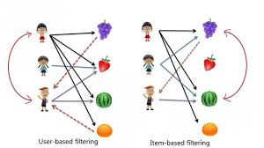
Model 1 – Collaborative Filtering
Proposed Model / Algorithm: Using the similarity among users / items as the weight and multiply the weight with the rating from users who have watched the movie.
There are multiple ways to calculate similarity
Cosine distance
Manhattan distance
Pearson correlation Coefficient

Slide 9
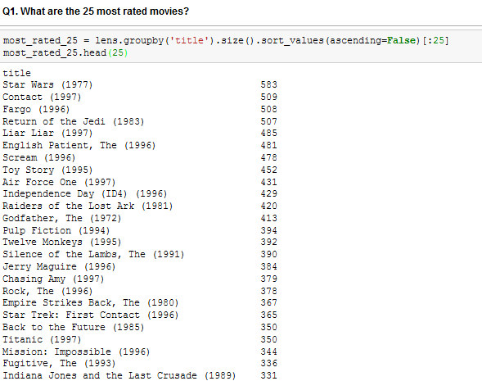
Model 1 – Collaborative Filtering
Top 25 Movies have at least 300 ratings
943 Users & 1682 Movies
There are enough users and movies to perform both item-based and user-based collaborative filtering.

Slide 10
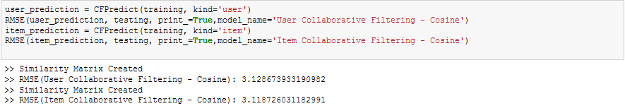
Model 1 – Collaborative Filtering
Result
After doing a train test split, we compare the predicted result with true value of the test set
The result is not particular great.
The problem is because we are looking at all the other ratings of the same user or same movies.
Example: Star Wars have 583 ratings. Getting dot product of 583 ratings and similarity may not make sense. Getting top k ratings (of other users) based with highest similarity score.

Slide 11
Model 2 – Matrix Factorization
Learn latent preferences of users and the latent attributes of items from known ratings (learn features that describe the characteristics of ratings) to then predict the unknown ratings through the dot product of the latent features of users and items.
Restructure the user-item matrix into low-rank structure, and you can represent the matrix by the multiplication of two low-rank matrices, where the rows contain the latent vector.
Latent factors can be considered as the genre of the movie, user's gender, users' occupation and etc. These characteristics do not have to be provided but SVD will discover such characteristics purely based on the existing ranking.

Slide 12
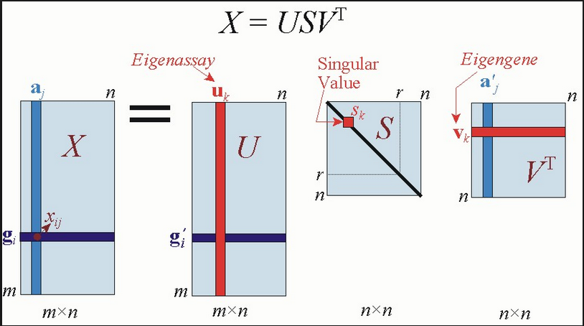
Model 2 – Matrix Factorization
Singule Vector Decomposition is the most popular Matrix Factorization approach.
SVD provides a transformation of the original data. This transformation has some very useful properties.
Given an m x n matrix X:
U is an m x r orthogonal matrix
S is an r x r diagonal matrix with non-negative real numbers on the diagonal
VT is an r x n orthogonal matrix

Slide 13
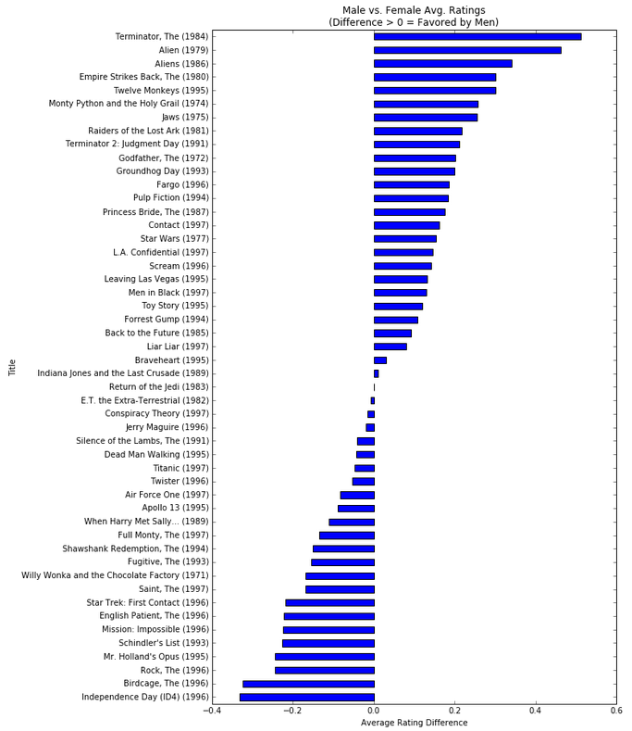
Model 2 – Matrix Factorization
Data Exploration Stage has identify rating for certain movies are affected by gender.
Terminator, Alien, Jaws are preferred by male.
However, Independecy Days (also an action movies) are preferred by female as well.
This can potentially be because of other features (e.g. actors) that is not easily noticeable.
SVD breaks down the user-movie ratings into latent factor and try to capture it.

Slide 14
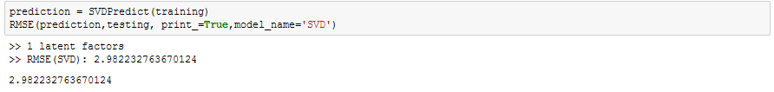
Model 2 – Matrix Factorization
Result
Do a cross validation to pick the k, number of latent factor for prediction.
Use the one that return the lower RMSE.
RMSE score is lower but still have more rooms to improve.
Example:

Slide 15
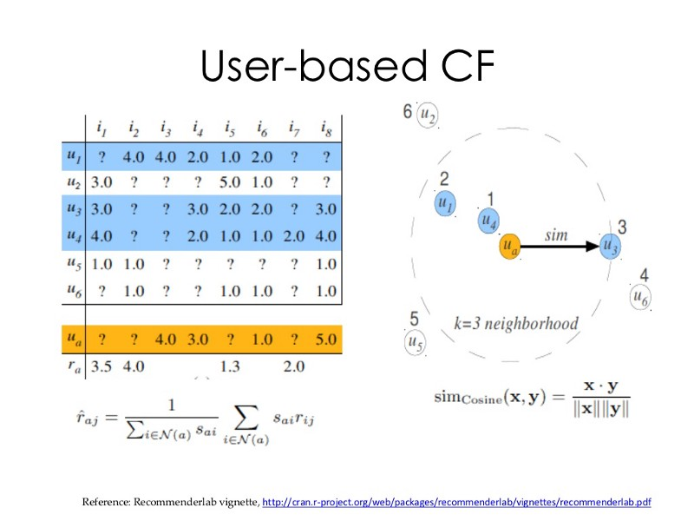
Model 3 – Collaborative Filtering + K Nearest Neighbor

Slide 16
Model 3 – Collaborative Filtering + K Nearest Neighbor
This is an extension of the Collaborative Filtering.
Instead of taking the rating of all users and multiply by the similarity, we can take only the k most similar users.
Similarity measurement would depend on the metrics picked – cosine, pearson, etc.

Slide 17
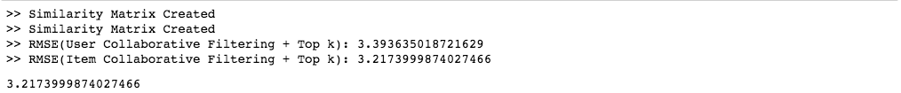
Model 3 – Collaborative Filtering + K Nearest Neighbor
Result
The score is worse than the CFPredict Model and just slightly better than the Mean Model.
This suggests we can use other ways to find similar users/items. Using users' age, gender, occupation or movies' genre an year can be other ways to pick the best user/items for collaborative filtering.

Slide 18
Result Comparison
Benchmark Model | Model 1 | Model 2 | Model 3
Mean Rating | Collaborative Filtering | Collaborative Filtering & kNN | SVD
User-based – 3.42 Item-based – 3.24 | User-based – 3.13 Item-based – 3.12 | User-based – 3.39 Item-based – 3.22 | SVD RMSE – 2.98

Slide 19
Next Step
In order to improve the prediction accuracy we can use other matrix factorization technique such as We alternating least square (ALS) or stochastic gradient descent (SGD) and uses regularization terms to prevent overfitting in future.
Take other dimension, user age, user occupation etc, of user to get similarity of users or genre, years, actors of movies to get similarity of items.
Advanced SVD algorithms such as Asymmetric SVD and SVD++
Temporal Effects - take time as one of the factor of prediction.
Ensemble Method

